Slide 1
Study on Accessibility
Alberto Rivero Monzón y José Mataix Pérez

Slide 2
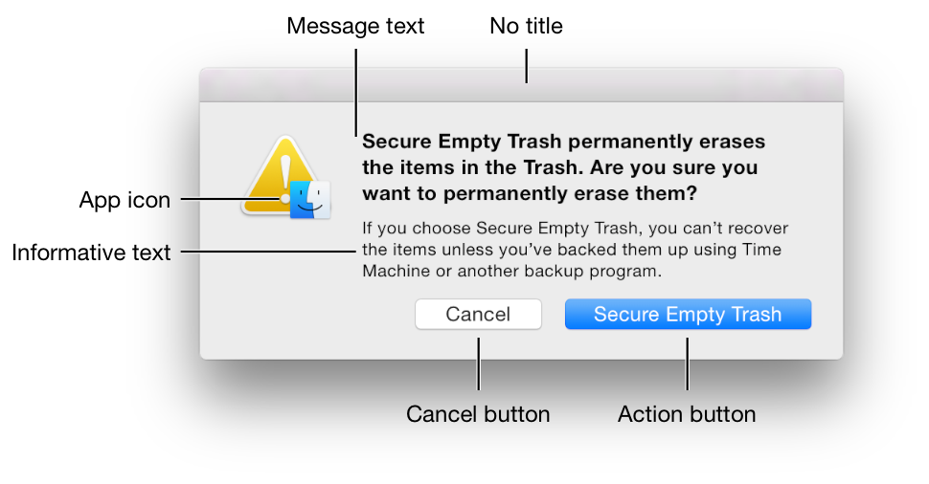
Strive for consistency.

Slide 3
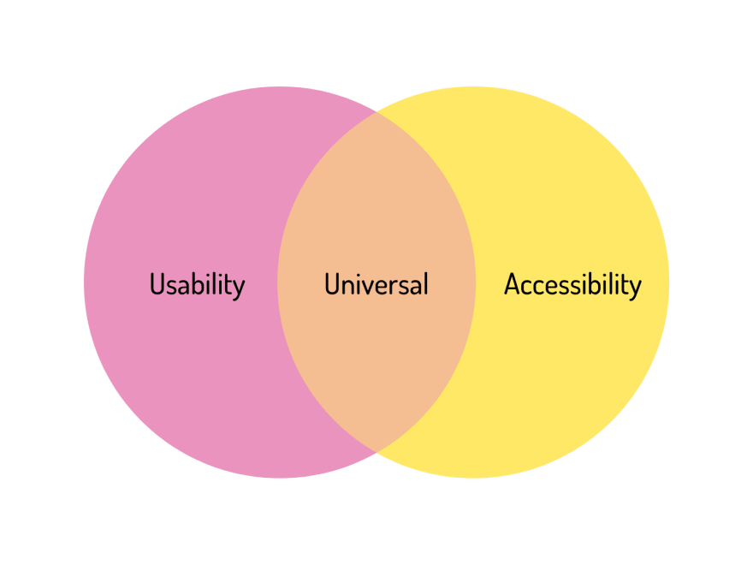
2. Seek universal usability.

Slide 4

3. Offer informative feedback.

Slide 5

4. Desing dialogs to yield closure.

Slide 6

5. Prevent errors.

Slide 7

6. Permit easy reversal of actions.

Slide 8

7. Keep users in control.

Slide 9
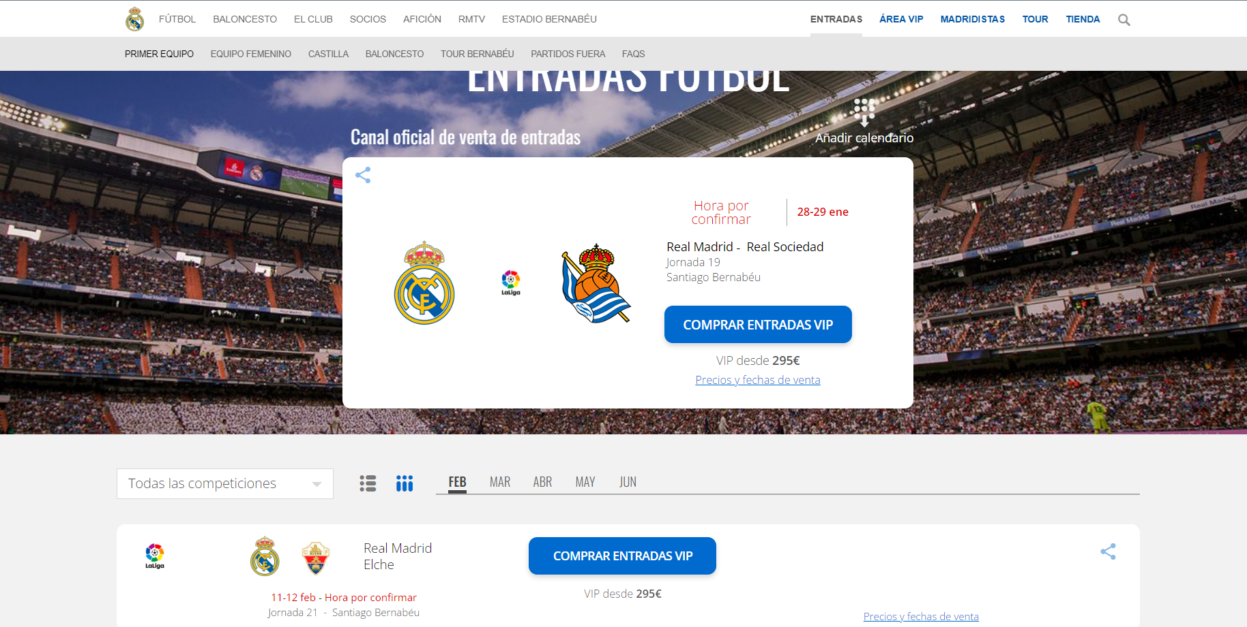
8. Reduce short-term memory load.

